Slide 1
Things in the sky
Birds, Planes, Clouds, and other Aerial Objects

Slide 2
What is the Sky
The sky is the space above the Earth's surface, including the atmosphere and outer space. It's the area where you can see clouds, stars, the sun, and the moon.

Slide 3

Types of Sky Objects
Man Made
Air-crafts, Satellites, Kites, Tall Buildings, Birds, etc
Natural
Sun, Moon, Stars, Clouds, etc

Slide 4
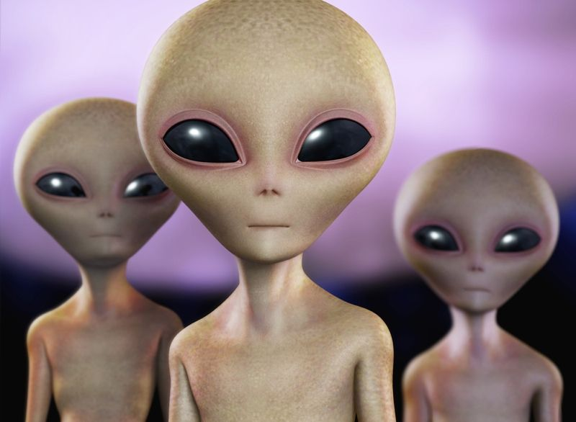
Aliens???????
Are They Real?
Government?

Slide 5

Want the
Truth?

